Slide 1
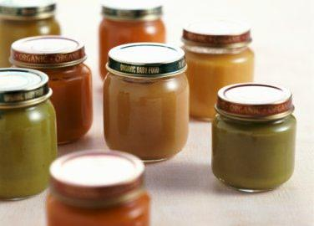
2023
Catawba County Schools-Early Head Start Community Assessment
Presented by:
Taylor Dellinger, GISP
Western Piedmont Council of Governments
CCS-EHS Policy Council-January 17, 2024

Slide 2
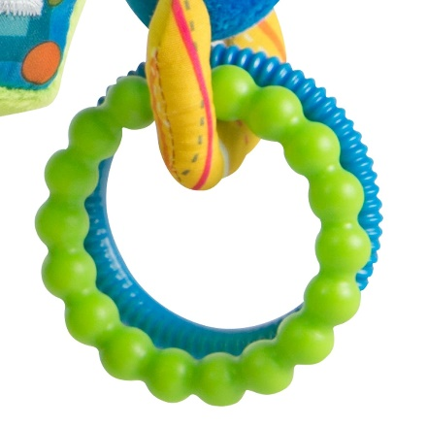
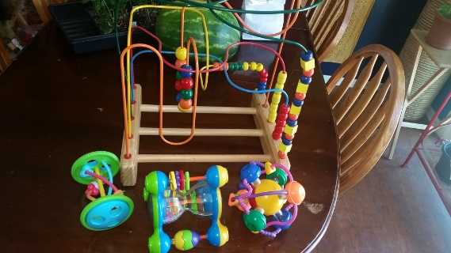
Purpose and Methodology
To present CCS-EHS Policy Board and staff with a thorough assessment of the current state of the physical, social and economic welfare of families with very young children in Catawba County, and provide an understanding of factors affecting this population.
The assessment also includes a variety of maps (Catawba County Census Tracts, Census Block Groups, and Elementary School Districts) to illustrate how various forms of hardship are experienced in communities throughout the County.
Data Sources include US Census Bureau, NC Department of Public Instruction, NC Department of Health and many others.
These Photos by Unknown Author is licensed under CC BY
This Photo by Unknown Author is licensed under CC BY
This Photo by Unknown Author is licensed under CC BY-NC

Slide 3
Organization
General Area Description & Demographics
CCS-EHS Eligible Families: Demographic, Economic & Social Characteristics
CCS-EHS-Eligible Families: Health & Nutrition Characteristics
Catawba County Housing Characteristics
Catawba County Child Care Characteristics
CCS-EHS-Eligible Families: Transportation & Communication
CCS-EHS Enrollment
CCS-EHS Staff
Community Needs Survey
Comprehensive Need Index

Slide 4
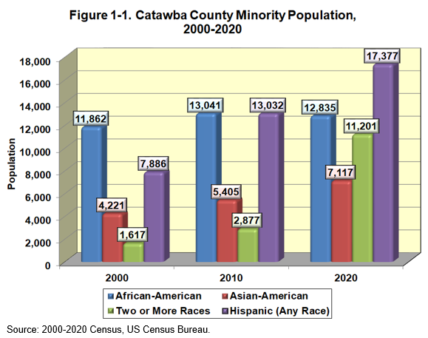
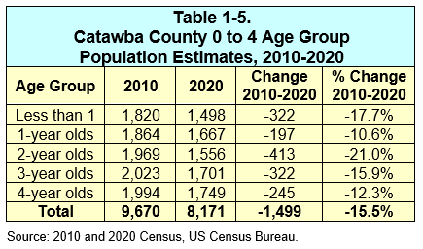
Section I: Area Description
Population Trends

Slide 5
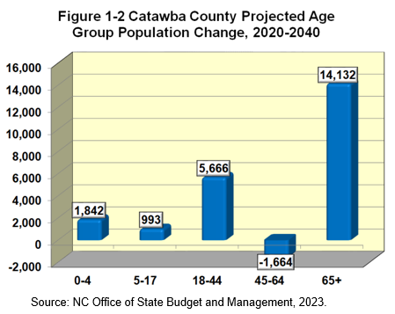
Section I: Area Description
Growth Projections by Age
After losing population between 2010 and 2020, some population growth is anticipated in the under age 5 population group over the next 20 years.
From 2020 to 2040, the age 65+ population is projected to increase by nearly 50%.

Slide 6
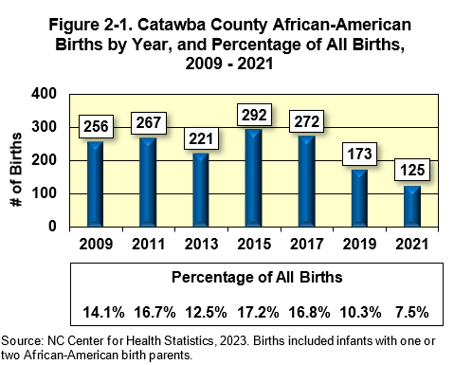
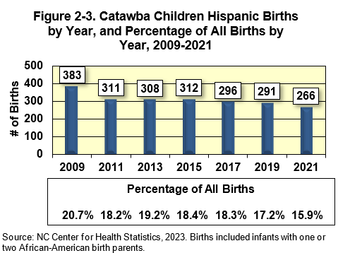
Section II: CCS-EHS Eligible Family Data
Catawba County Birth Trends
The total number of Catawba County Births has fallen from 1,754 in 2015 to 1,674 in 2021.
The number of African-American and Hispanic births have declined over the past decade.

Slide 7
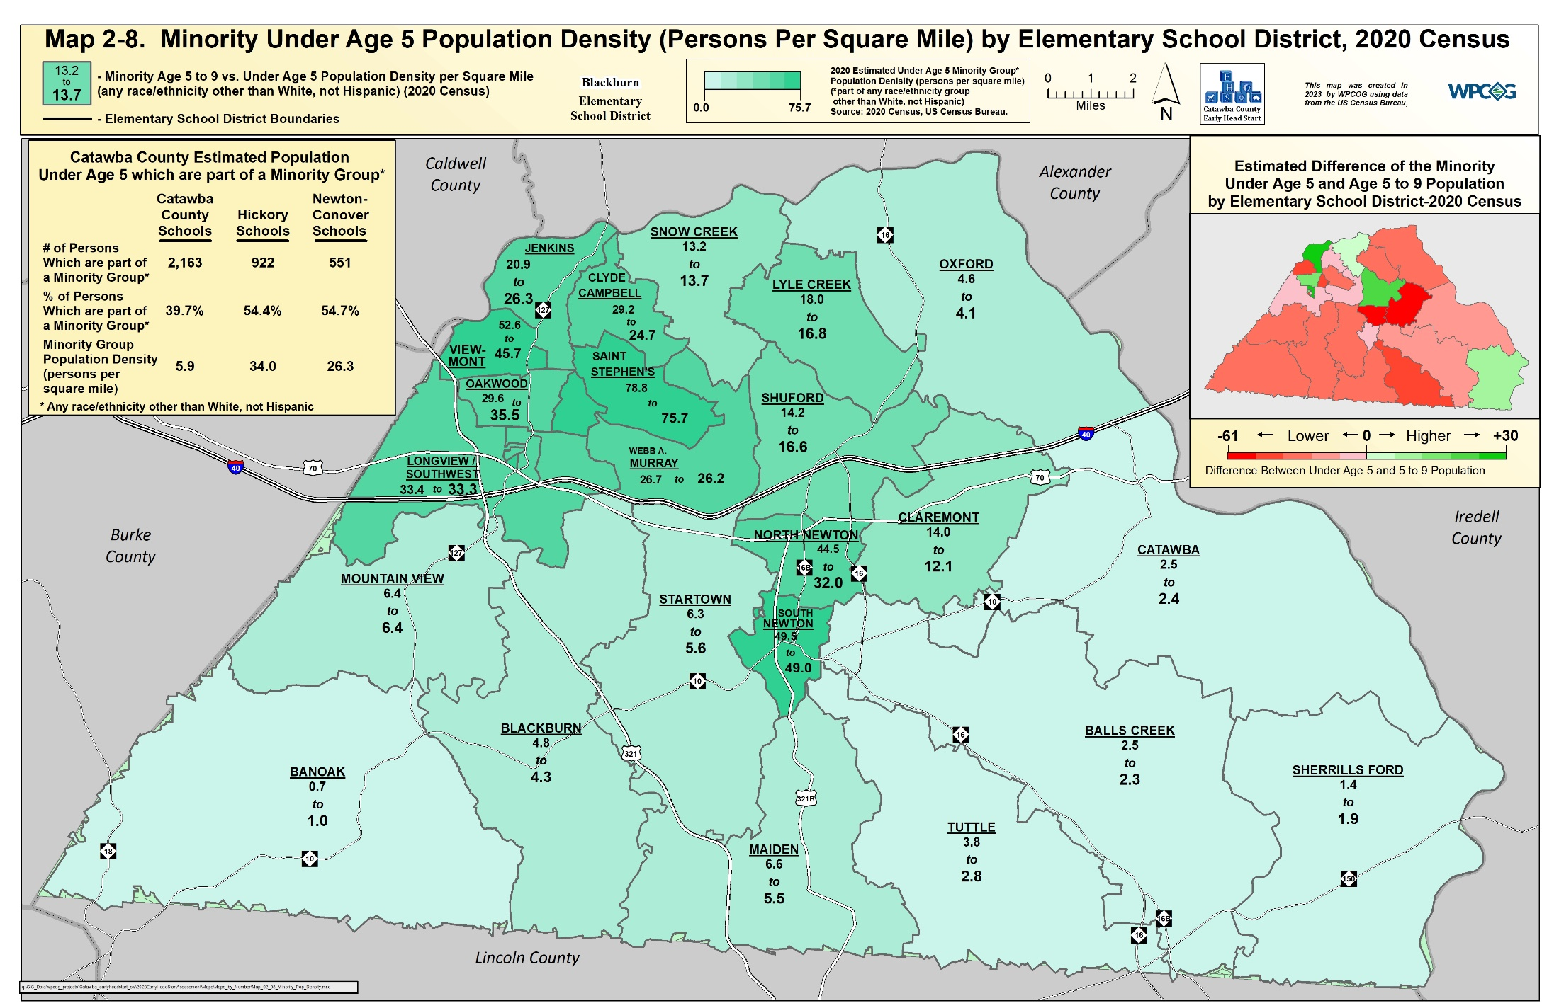

Slide 8
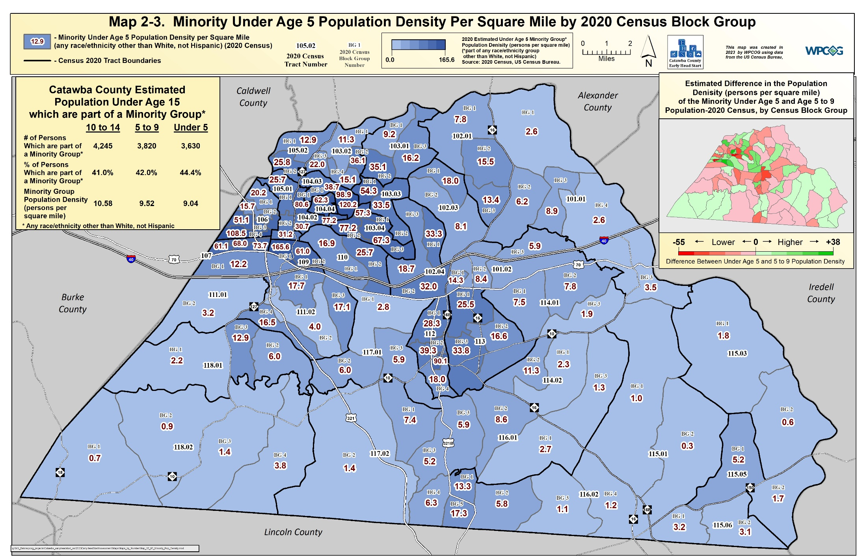
Notes:
(Page 14) Minority Births 4,633 to 4,112 (-521) or -11.2%
Non-Minority Births 5,152 to 4,194 (-958) or -18.6%
So, as % of all births, minorities rose from 49.2% to 49.4% (typo in book).

Slide 9
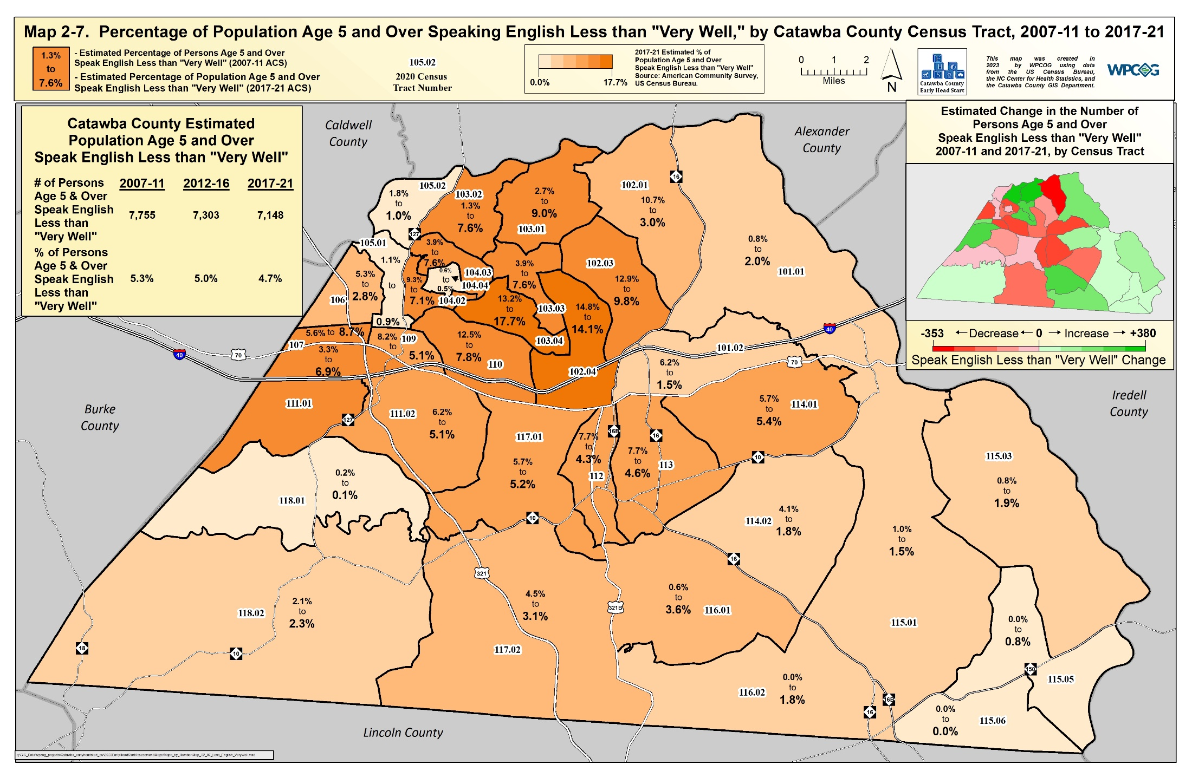
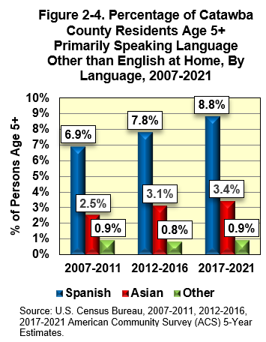

Slide 10
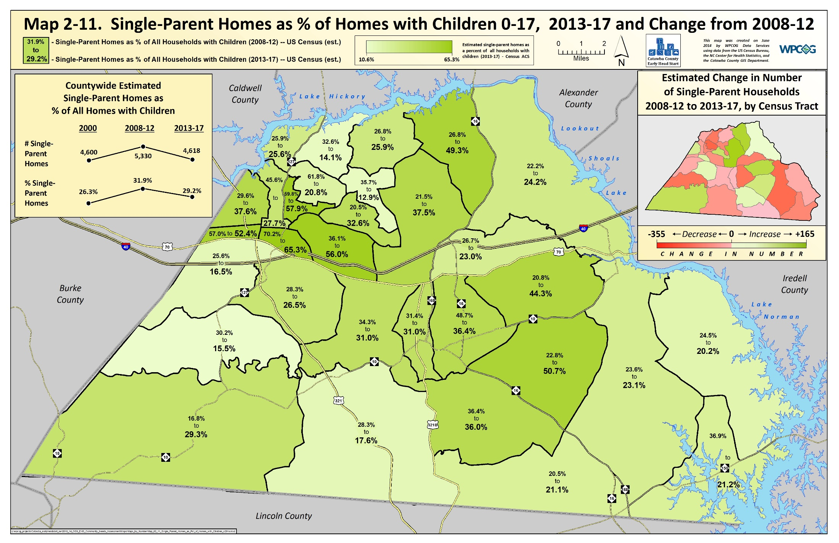
Notes:
Note Mountain View. Also note western Oxford, where Asians (with lower divorce/single mothers) are moving/growing.

Slide 11
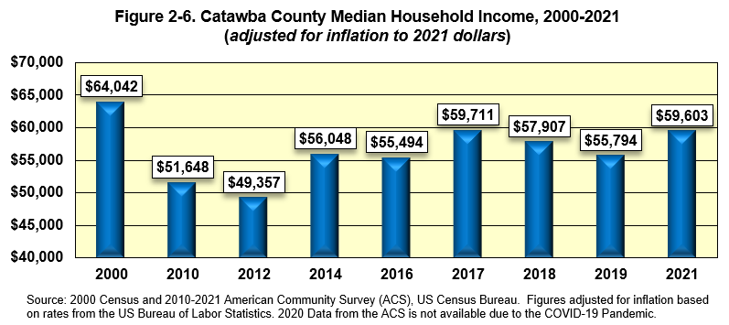
Section II: CCS-EHS Eligible Family Data
Median Household Income
Catawba County median household income (when adjusted for inflation) is less in 2021 than in 2000.
From 2019 to 2021, Catawba County median household income (adjusted for inflation) has grown from $55,794 to $59,603.
Notes:
From 2012 to 2017, Catawba Co MHI was been growing faster (21.0%) than the State (9.4%) and Nation (10.0%). (adj. for inflation)

Slide 12
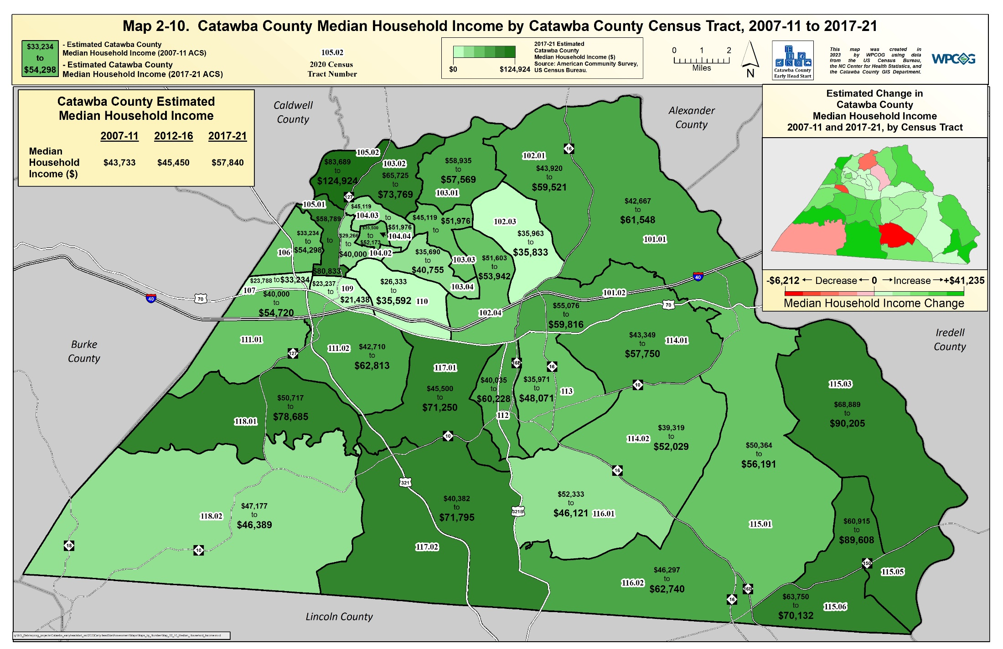

Slide 13
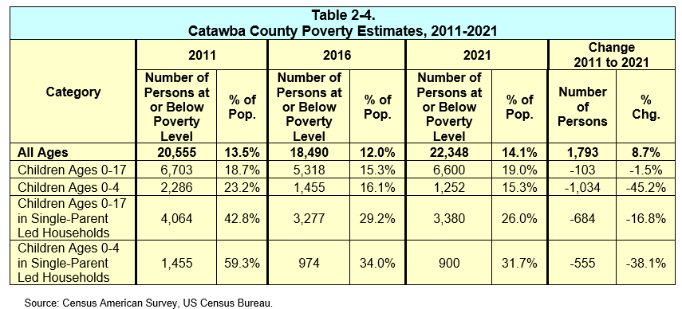
Section II: CCS-EHS Eligible Family Data
Catawba County Poverty Trends (2011 to 2021)
Federal poverty level for households with one parent and one child was $17,420.
The County’s young children poverty rate in 2021 was lower than previous years, mainly due to pandemic related programs.

Slide 14
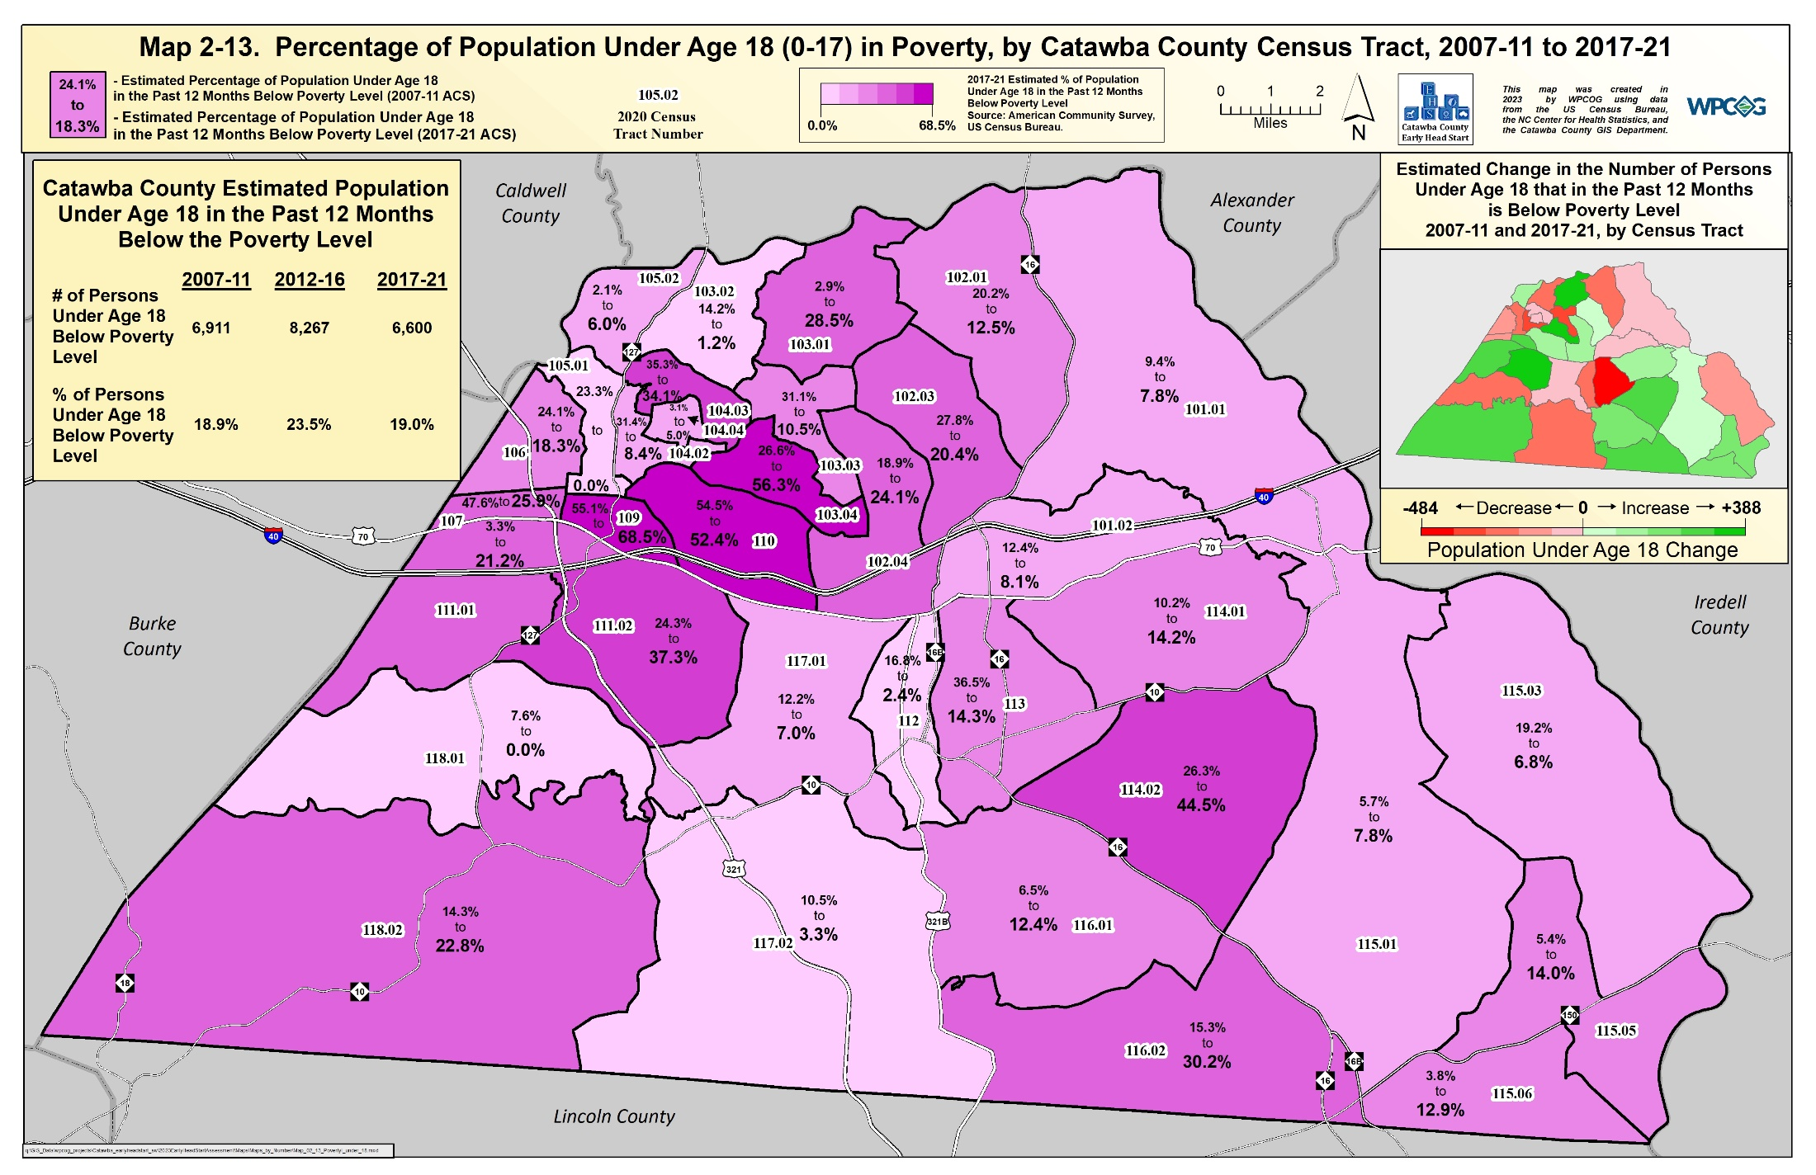

Slide 15
Section II: CCS-EHS Eligible Family Data
Public Assistance
The number of households receiving some form of public assistance has grown dramatically over the past decade.
Annual expenditures of SNAP have nearly tripled from $22.7 million in 2019 to $77.6 million in 2017.

Slide 16
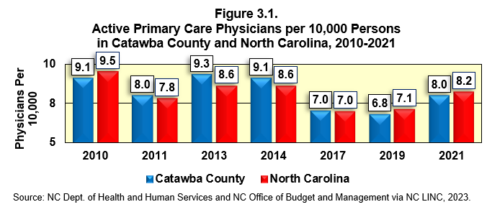
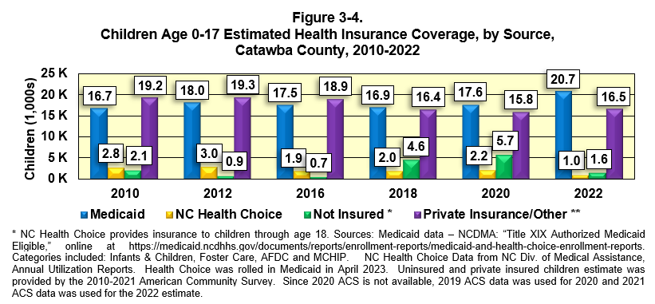
Section III: CCS-EHS Eligible Health & Nutrition
Physician Access
Since 2017, the number of primary care physicians in Catawba County increased relative to the population.
Children’s Health Insurance Coverage
In 2022, about 55% of Catawba County children were covered by Medicaid or NC Health Choice.
Catawba had more than 1,600 uninsured children in 2022.

Slide 17
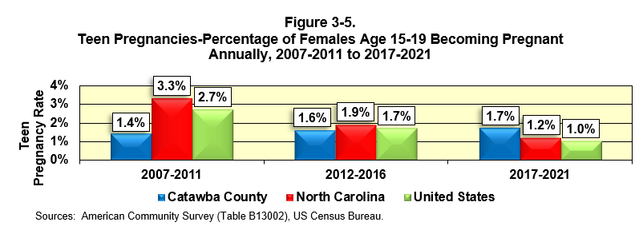
Section III: CCS-EHS Eligible Health & Nutrition
Teen Pregnancies
Catawba County teen pregnancy rate has increased slightly over the last ten years and is higher than the State or US.
Prenatal Care
A higher percentage of Catawba County mothers received prenatal care in 2020 than in 2014.

Slide 18
Section III: CCS-EHS Eligible Health & Nutrition
Food Deserts
“Food Deserts” are urban or rural areas of elevated poverty which do not have easy access to a supermarket.
Often found in areas of large minority populations.
Healthy food is either unavailable or too expensive at small convenience stores.
Families often faced with choosing cheaper foods in small food stores, which contain high amounts of fat and calories, or eat inexpensive items at fast-food outlets, which are also often unhealthy.
Food deserts lead to health problems and obesity, particularly among children.

Slide 19
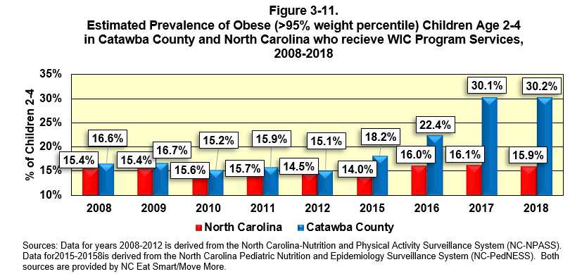
Section III: CCS-EHS Eligible Health & Nutrition
Childhood Obesity and Food Deserts
From 2012 to 2018, obesity in Catawba County children age 2-4 increased from 15.1% to 30.2%.

Slide 20
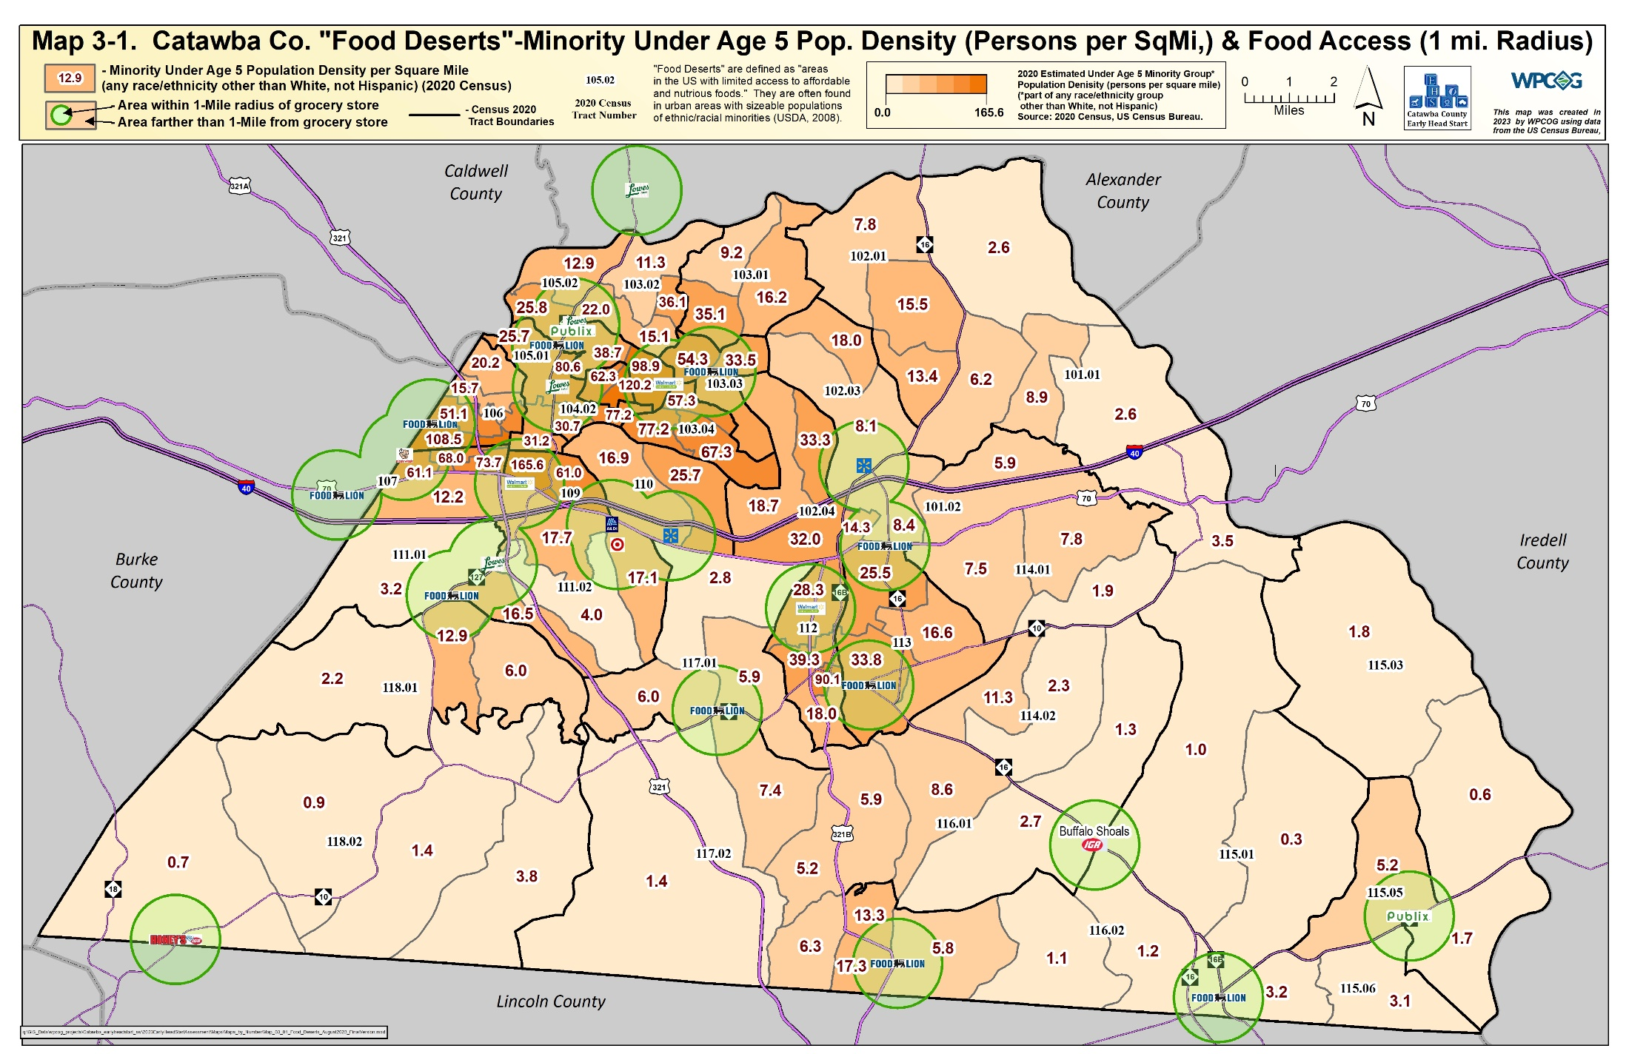

Slide 21
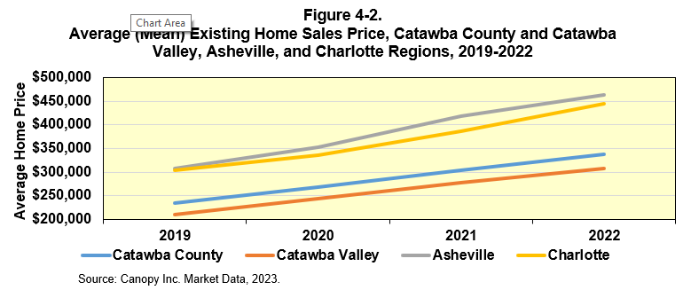
Section IV: Housing in Catawba County
Rapidly Rising Housing Costs
Between 2019 and 2022, existing home sale prices have risen 44.2% from $234,741 to $333,410. The price increase is much higher than the inflation rate (15.5%) from 2019 to 2022.
On average, homes sold in Catawba County in 2022 were more than $30,000 higher than the Catawba Valley region, but were more than $100,000 less than the Asheville and Charlotte regions.
This trend should cause continued in-migration to Catawba County despite the rapid rise in home prices over the last few years.

Slide 22
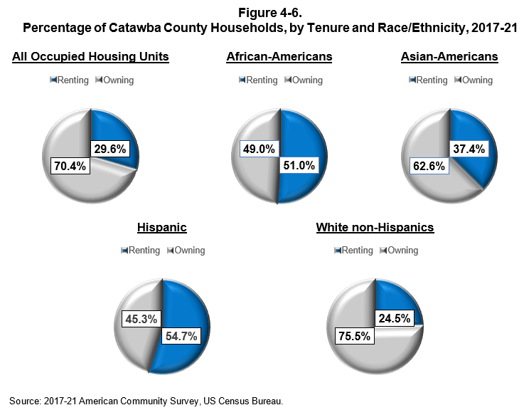
Section IV: Housing in Catawba County
Renting versus Owning (cont.)
Catawba County African-American and Hispanic families were more likely to rent homes, while White (non-Hispanic) and Asian-American families were more likely to be homeowners.

Slide 23
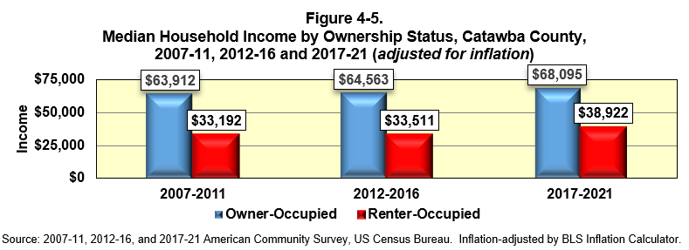
Section IV: Housing in Catawba County
Household Income of Renters versus Owners
Household income for both owner- and renter-occupied households increased between 2012-16 and 2017-21.
Catawba County renters have only about half the median household income of Catawba County homeowners.

Slide 24
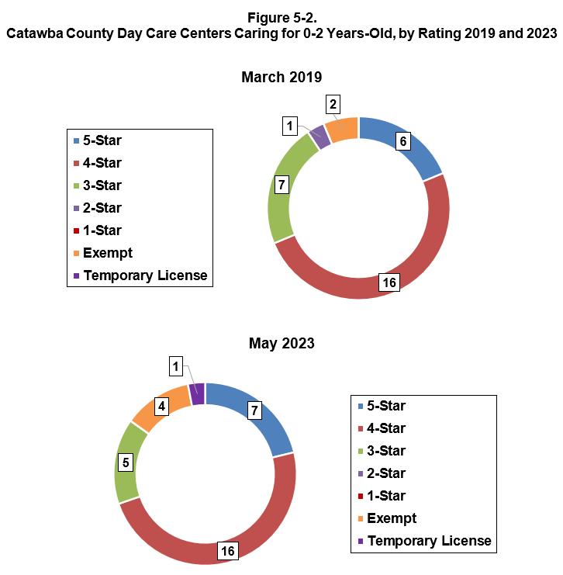
Section V: Child Care in Catawba County
Day Care Ratings
The number of 5-star centers increased from 6 to 7 between March 2019 and 2023.
In 2022, a Catawba County one-star center would receive $379 per month to care for an infant, while a five-star center would receive $1,018 (a difference of $639 or 168.6% higher than a one-star center reimbursement).

Slide 25
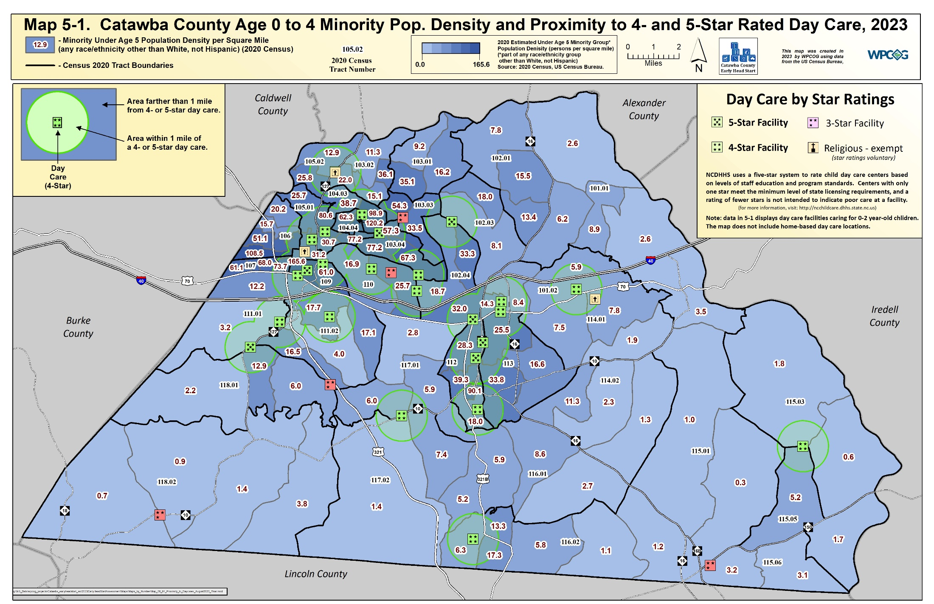

Slide 26
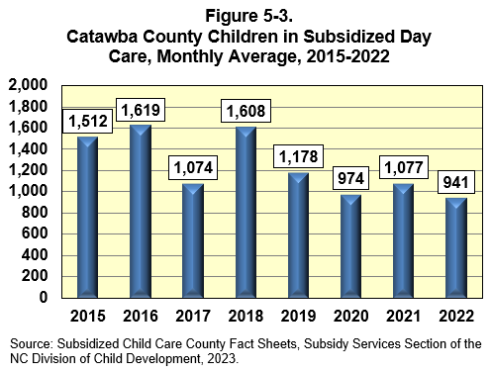
Section V: Child Care in Catawba County
Subsidized Day Care
The NC Early Education Coalition states that only 26.7% of families in the State can afford child care without exceeding the federal recommendation of spending no more than 10 percent of household income on child care. State average annual cost of day care for an infant is $9,522.
In Catawba County, the number of children receiving subsidized day care has decreased significantly from 1,608 children per month in 2018 to 941 children per month in 2022.
In 2022, only 34.5% of all potentially eligible children (defined as children under age 0-5 whose parent(s) are working and whose family income is at or below the 200% federal poverty level, or children age 6-11 whose family income is at or below 133% federal poverty level) are receiving subsidized child care assistance.

Slide 27
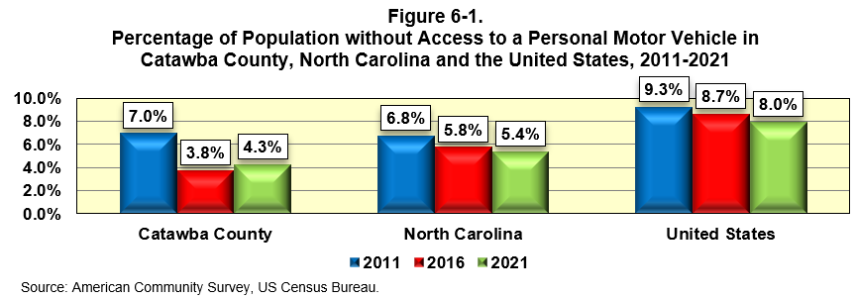
Section VI: Transportation & Communication
Access to Personal Motor Vehicle
The proportion of County residents with no access to a motor vehicle is lower than in US or NC, but has increased between 2016-2021.
There are many residents in Catawba County (nearly 2,800 households as of 2021) without vehicle access. Lack of transportation is a serious issue for Early Head Start parents.

Slide 28
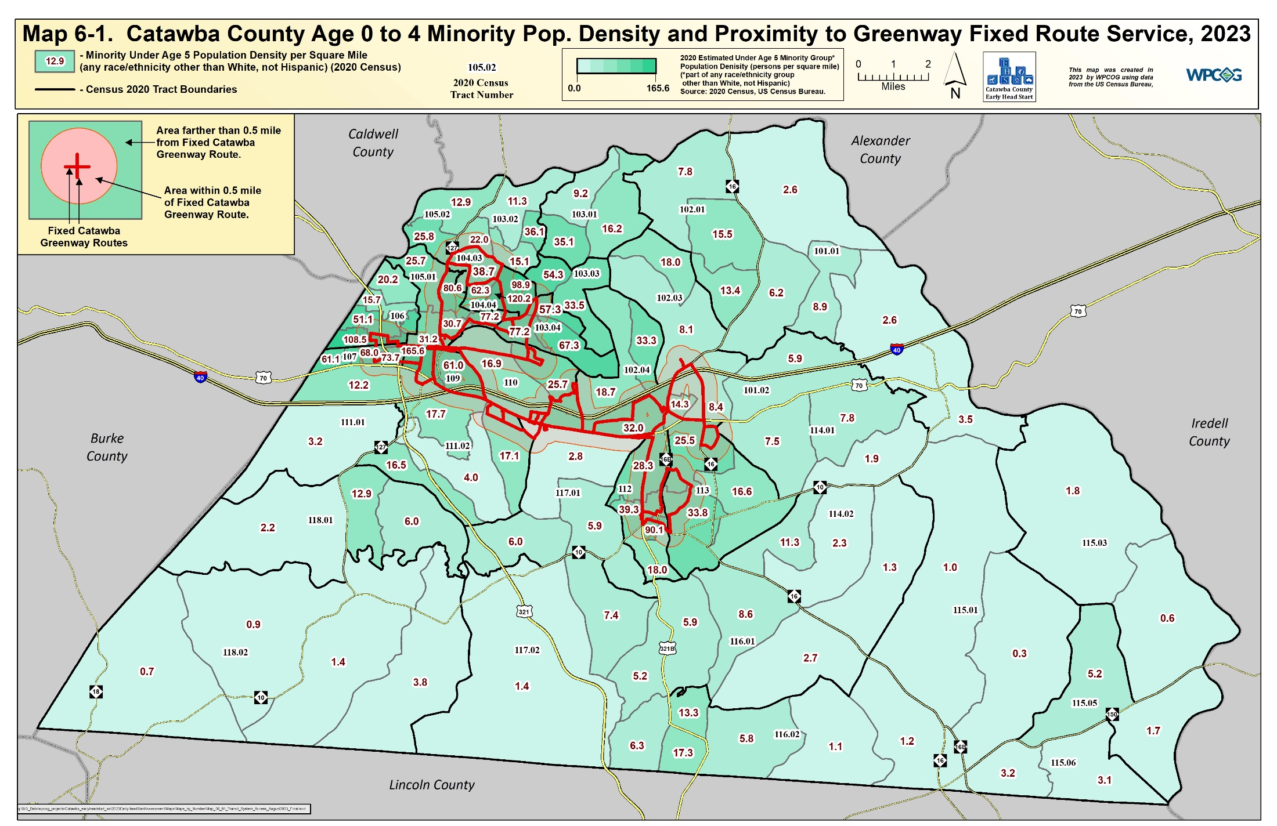
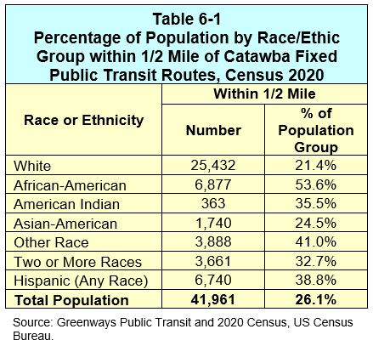

Slide 29
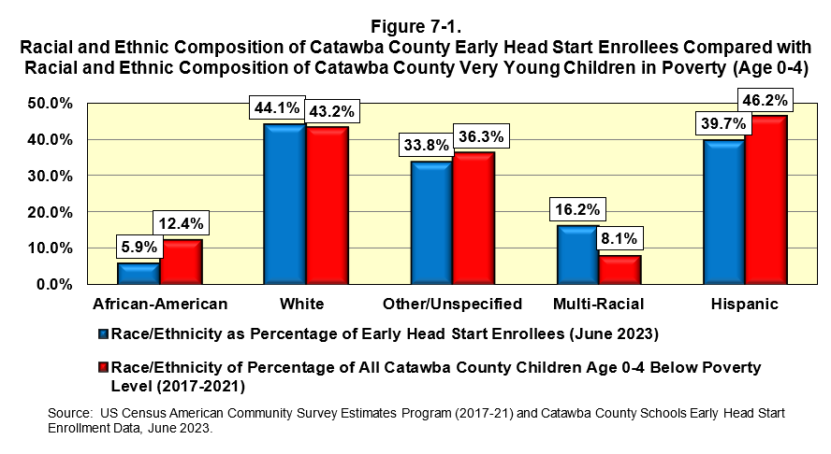
Section VII: CCS-EHS Enrollees and Section VIII: CCS-EHS Staff
Poverty Representation and Enrollment
CCS-EHS employs 11 persons with one speaking both English and Spanish.
CCS-EHS enrollment dropped from 129 children in 2019 to 68 children in 2023 (-47.3%)
Enrollment in CCS-EHS appears to be generally representative of the ethnicity/race of very young children in poverty in the County.

Slide 30
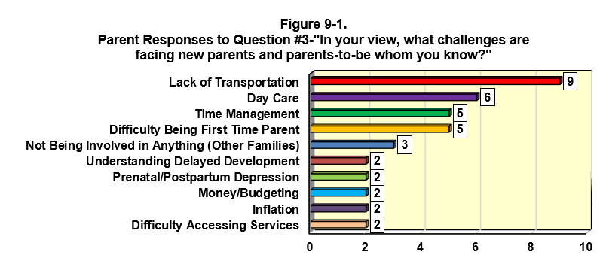
Section IX: Community Needs Survey
Survey Description
46 parents/guardians of CCS-EHS enrolled children, 9 EHS staff and 13 CCS-EHS cooperating agencies responded to a one-page survey regarding the challenges faced by Early Head Start in Catawba County and how the program can achieve its goals.

Slide 31
Section IX: Community Needs Survey
Sample Answers to Question #4:
“In your opinion, what actions can CCS-EHS take to better serve the needs of parents and parents-to be?”
“Need a Mom-To-Be groups”
“Teach techniques to help children with routines”
“Teach/Help/Learn how to incorporate activities to connect physically, mentally, emotionally”
“Lessons on credit and money management”
“Offer the program to more families in the Latino Community”
More Parenting Classes/Support Groups
More Growth and Transportation Needs
“Partner with Greenway to assist with transportation for our families”
“Offer the program to parents who are isolated and with few friends”
“It would be nice if CCS had Head Start under the umbrella in order to better serve the families in need”

Slide 32
Section IX: Community Needs Survey
Sample Answers to Question #5:
“What obstacles do you see to CCS-EHS serving this population?”
CCS-EHS Staff Responses
“Funding/Financial Obstacles” (Mentioned 3 times)
“Reaching families when they don't know about us and we don't know about them (especially rural families)” (Mentioned 3 times)
“Parents who are not willing to do the program” (Mentioned 2 times)
CCS-EHS Coordinating Agency Responses
“I feel that there are way more that need to be served and there is not enough awareness, funding, or staff to do it”.
“There is a lot of turnover in the programs we refer our families too and therefore maintaining consistency in sharing the process and having a direct line of communication is a barrier.”
“Building trust and relationships”

Slide 33
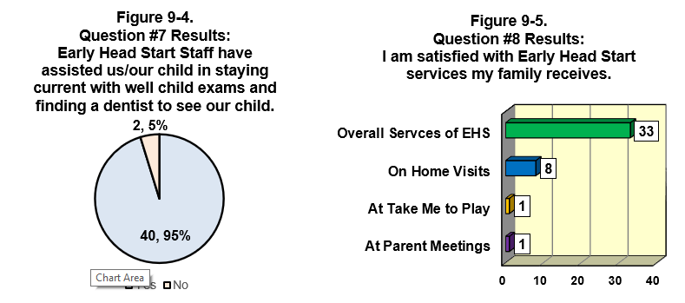
Section IX: Community Needs Survey
All survey takers said that the EHS program had helped them better understand their child’s social-emotional development, language development, learning concepts (shapes, sizes etc.) through play, and motor development.

Slide 34
Section X: Comprehensive Need Index for Early Head Start Services
Index Description and Components
The purpose of the Index and Index map is show overall trends in the need for Early Head Start services in Catawba County.
Catawba County was divided in 99 areas (Census Block Groups).
For each Block Group, all indicators of need were statistically weighted based on an estimation on how much each category contributed to the overall need for CCS-EHS services, as well as its mandates to serve various populations in the County.
The scores for each category were then added together. The higher the Index score, the greater the need for Early Head Start Services. The minimum index score could be 0 (lowest need) and the highest score could be 100 (highest need).

Slide 35
Section X: Comprehensive Need Index for Early Head Start Services
Index Components and Weighting
Components and Weighting of Catawba County Comprehensive Need Index for Early Head Start Services, 2023
Category |  | Weight | Category |  | Weight
Economic Need (total) |  | 35% | Minority / Cultural Status (total) |  | 30%
 | % of Children in Poverty | 20% |  | Under Age 5 Minority Population Density per Square Mile (2017-2021) | 20%
 | Median Household Income | 10%
 | % of Workforce in Manufacturing | 5% |  | % Speaking English Less than “Very Well” | 10%
 |  |  | Lack of Access to Services (total) |  | 15%
Family Structure (total) |  | 10% |  | Access to Affordable Nutrition ("Food Deserts") | 5%
 | Single-Parent Households as % of Households with Children | 10% |  | Access to 4- and 5-Star Day Care | 5%
Educational Attainment (total) |  | 10% |  | Access to Public Transit | 5%
 | % Adults 25+ Not Finishing High School | 10%
The most weight in the Index was given to percentage of children in poverty (20% of the total score) and under age 5 minority population density (20% of the total score).

Slide 36
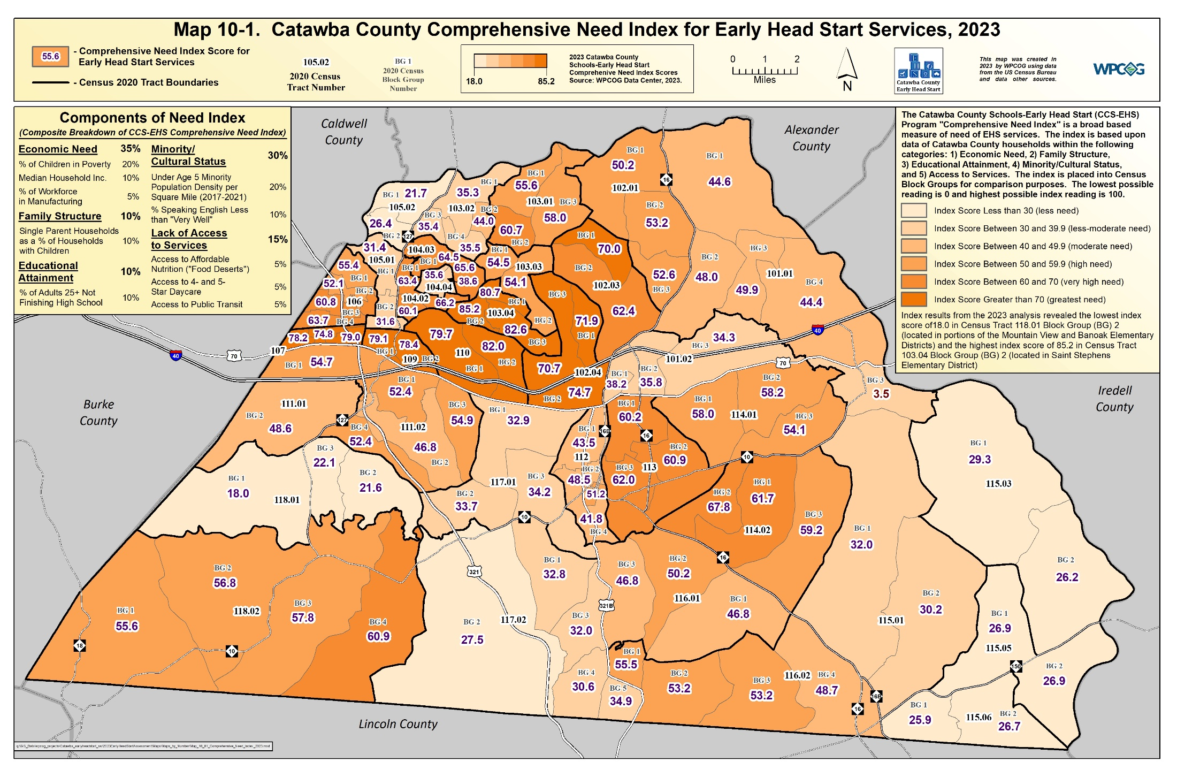

Slide 37
Section X: Comprehensive Need Index for Early Head Start Services
Index Results
The highest index scores indicating the highest need for Early Start Services occurred in area from portions of Long View and West Hickory to Ridgeview and Highland areas in Hickory
These areas had high index scores due to higher poverty rates and higher under age 5 minority population.
Higher index scores were also found north of Conover in the Lyle Creek area and the east side of Newton
Sherrills Ford, and portions of Viewmont and Mountain View were areas with lowest index scores (least need).
It should be noted that the Index score does not mean that an individual family in low scoring census block groups do not need Early Head Start services.

Slide 38
SUMMARY OF FINDINGS
A continued loss of adults younger than age 35, and their families, leading to a lower population of children, affecting all major races and ethnicities in the County.
A continued rise in non-English being spoken at home, including Spanish, as well as a growth in several Asian languages.
Census Results show a decrease in the number of Catawba County children under age 5 below poverty level (due to pandemic related programs). However, in portions of the County, the age 0 to 17 poverty rate exceeds 50%.
The percentage of mothers receiving prenatal care in the first trimester increased from 72.8% in 2014 to 79.5% in 2020.
Lack of transportation access remains a major issue for Early Head Start parents.
Overall, CCS-EHS parents and coordinating agencies were pleased with the Early Head Start Program

Slide 39
Questions?
2023
Catawba County Schools-Early Head Start Community Assessment
Contact Information
Taylor Dellinger, GISP (828)-485-4233 email: taylor.dellinger@wpcog.org

